Slide 1
Gravitational Waves
Sam Grobelny, Sacha Wible, Wentao Zhong

Slide 2
Motivations
Methods + Assumptions
By studying black hole mergers via gravitational waves, we can figure out the distance from Earth. Comparing this to redshift of the light from these events allows us to better understand the universe's expansion.
By using gravitational wave data collected from LIGO we should be able to calculate the masses of the two black holes that merged in order to cause the wave.
Using data from the two different locations, we assume the Earth is round in order to account for their distance difference in order to line up the data.

Slide 3
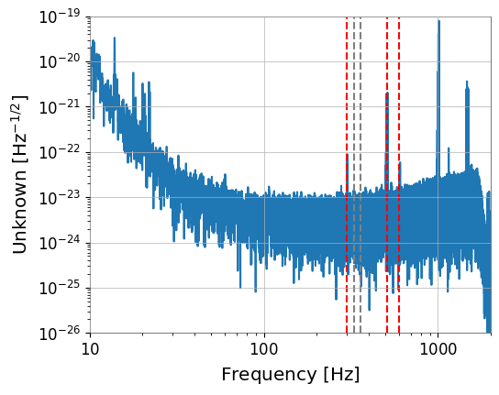
Fast Fourier transform - GW200224_222234
Notes:
By transforming the data into a frequency domain, its easier to tell which frequencies dominate the sample and how they vary over time, as well as improving the Signal to Noise ratio

Slide 4
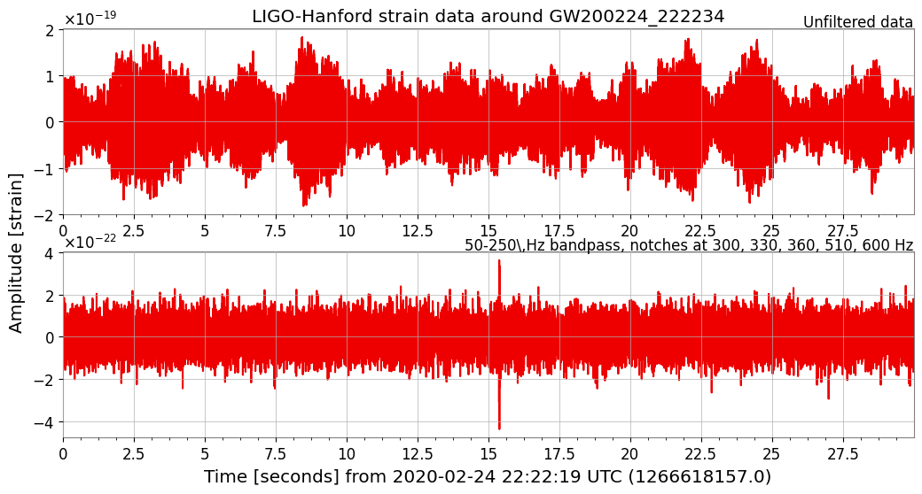
Notes:
Before vs after now there is much less noise.

Slide 5
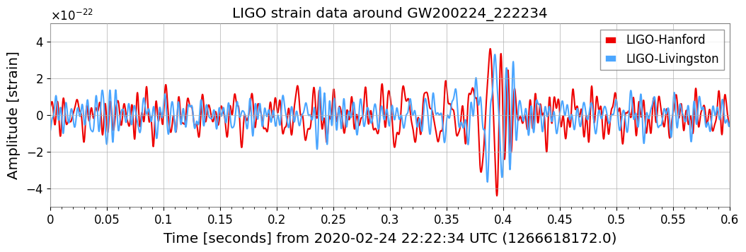
Notes:
Strain is the change in distance caused by the gravitational wave

Slide 6
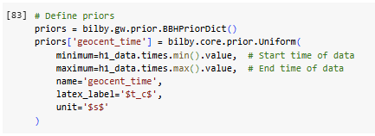
Mass of the Black Holes: Bilby
Priors: Probability distributions for each model parameter
Bilby: Python library for Bayesian inference, used to estimate parameters of signals from gravitational waves
Bayesian inference: Statistical inference used to calculate probability
Compares observed gravitational wave data with generated waveforms.
Specifying the time of arrival of the signal

Slide 7

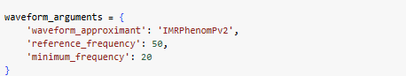
There’s More
Interferometers: Used to detect and measure gravitational waves
Assigning both the Hanford and Livingston detector
waveform_argument: specifies parameters that define the waveform being modeled
Allows for more effective parameter estimation

Slide 8
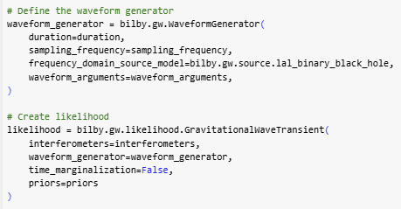
2 More 2 Furious
waveform_generator: Responsible for creating gravitational waveforms
frequency_domain_source_model=bilby.gw.source.lal_binary_black_hole: Specifies a binary black hole merger model
Likelihood: Quantifies how probable the observed data is based on parameter values
time_marginalization=False: specifies the time of signal

Slide 9
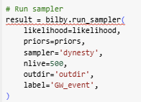
The Finale
bilby.run_sampler: Executes the sampling algorithm
sampler=’dynesty’: Sampling method dynasty is common in gravitational wave problems
nlive=500: Sets the number of “live points” used by the algorithm. Basically, the accuracy.
outdir=’outdir’: Specifies output directory
Hey, what’s that red line…

Slide 10

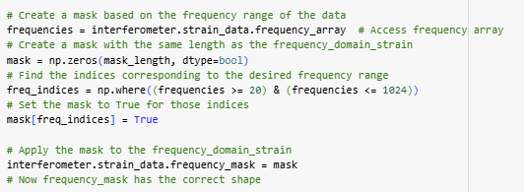
I Lied

Slide 11
Conclusion
AI Acknowledgement
“My” code does not work. And it’s hardly mine.
So much of it. And for what.

